Slide 1
CI32/CY32 -DBS
UNIT 5

Slide 2
Introduction to Transaction Processing
Why Concurrency Control is needed:
The Lost Update Problem
This occurs when two transactions that access the same database items have their operations interleaved in a way that makes the value of some database item incorrect.
The Temporary Update (or Dirty Read) Problem
This occurs when one transaction updates a database item and then the transaction fails for some reason (see Section 17.1.4).
The updated item is accessed by another transaction before it is changed back to its original value.
The Incorrect Summary Problem
If one transaction is calculating an aggregate summary function on a number of records while other transactions are updating some of these records, the aggregate function may calculate some values before they are updated and others after they are updated.

Slide 3
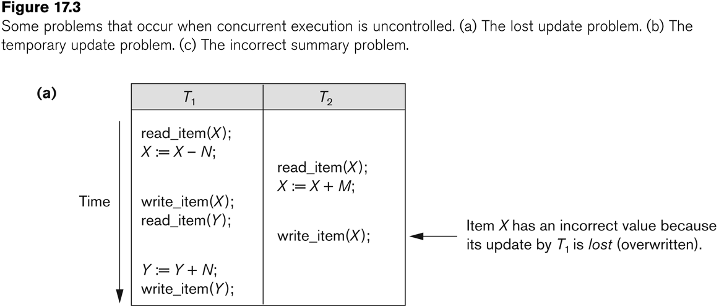
Concurrent execution is uncontrolled: (a) The lost update problem.

Slide 4
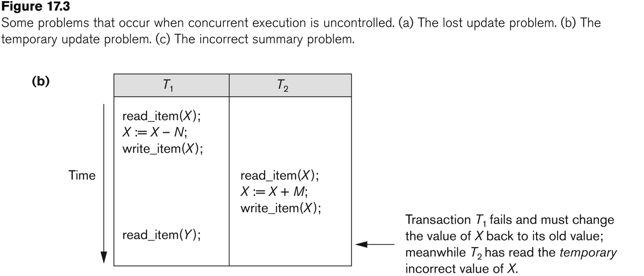
Concurrent execution is uncontrolled: (b) The temporary update problem.

Slide 5
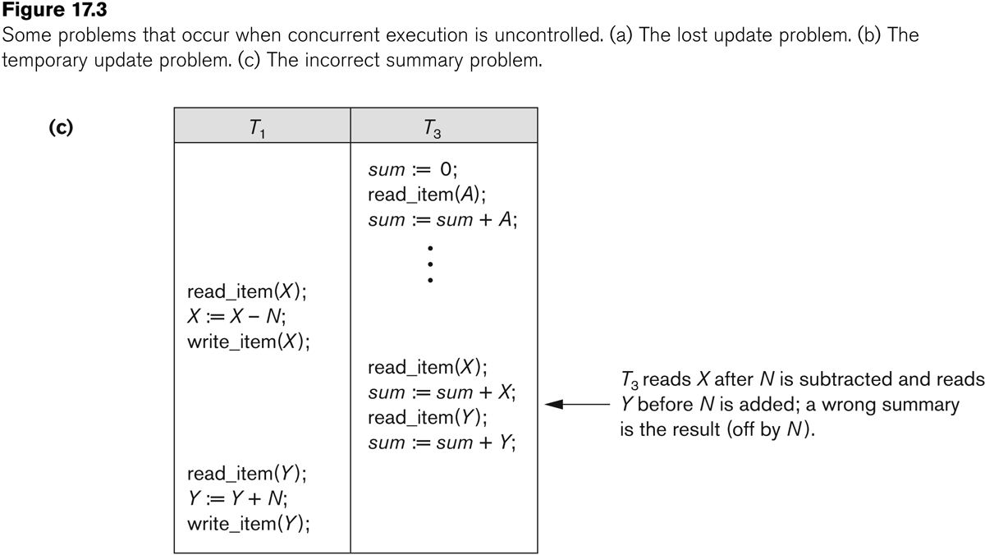
Concurrent execution is uncontrolled: (c) The incorrect summary problem.

Slide 6
Introduction to Transaction Processing
Why recovery is needed:
(What causes a Transaction to fail)
1. A computer failure (system crash):
A hardware or software error occurs in the computer system during transaction execution. If the hardware crashes, the contents of the computer’s internal memory may be lost.
2. A transaction or system error:
Some operation in the transaction may cause it to fail, such as integer overflow or division by zero. Transaction failure may also occur because of erroneous parameter values or because of a logical programming error. In addition, the user may interrupt the transaction during its execution.

Slide 7
Introduction to Transaction Processing
Why recovery is needed (Contd.):
(What causes a Transaction to fail)
3. Local errors or exception conditions detected by the transaction:
Certain conditions necessitate cancellation of the transaction. For example, data for the transaction may not be found. A condition, such as insufficient account balance in a banking database, may cause a transaction, such as a fund withdrawal from that account, to be canceled.
A programmed abort in the transaction causes it to fail.
4. Concurrency control enforcement:
The concurrency control method may decide to abort the transaction, to be restarted later, because it violates serializability or because several transactions are in a state of deadlock .

Slide 8
Introduction to Transaction Processing
Why recovery is needed (contd.):
(What causes a Transaction to fail)
5. Disk failure:
Some disk blocks may lose their data because of a read or write malfunction or because of a disk read/write head crash. This may happen during a read or a write operation of the transaction.
6. Physical problems and catastrophes:
This refers to an endless list of problems that includes power or air-conditioning failure, fire, theft, sabotage, overwriting disks or tapes by mistake, and mounting of a wrong tape by the operator.

Slide 9
Transaction and System Concepts
A transaction is an atomic unit of work that is either completed in its entirety or not done at all.
For recovery purposes, the system needs to keep track of when the transaction starts, terminates, and commits or aborts.
Transaction states:
Active state
Partially committed state
Committed state
Failed state
Terminated State

Slide 10
Transaction and System Concepts
Recovery manager keeps track of the following operations:
begin_transaction: This marks the beginning of transaction execution.
read or write: These specify read or write operations on the database items that are executed as part of a transaction.
end_transaction: This specifies that read and write transaction operations have ended and marks the end limit of transaction execution.
At this point it may be necessary to check whether the changes introduced by the transaction can be permanently applied to the database or whether the transaction has to be aborted because it violates concurrency control or for some other reason.

Slide 11
Transaction and System Concepts
Recovery manager keeps track of the following operations (cont):
commit_transaction: This signals a successful end of the transaction so that any changes (updates) executed by the transaction can be safely committed to the database and will not be undone.
rollback (or abort): This signals that the transaction has ended unsuccessfully, so that any changes or effects that the transaction may have applied to the database must be undone.

Slide 12
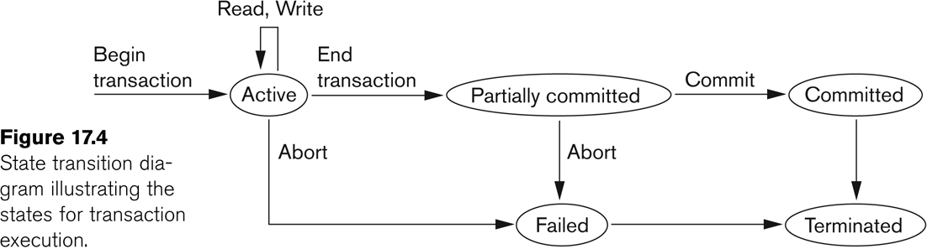
State transition diagram illustrating the states for transaction execution

Slide 13
Transaction and System Concepts
The System Log
Log or Journal: The log keeps track of all transaction operations that affect the values of database items.
This information may be needed to permit recovery from transaction failures.
The log is kept on disk, so it is not affected by any type of failure except for disk or catastrophic failure.
In addition, the log is periodically backed up to archival storage (tape) to guard against such catastrophic failures.

Slide 14
Transaction and System Concepts
The System Log (cont):
T in the following discussion refers to a unique transaction-id that is generated automatically by the system and is used to identify each transaction:
Types of log record:
[start_transaction,T]: Records that transaction T has started execution.
[write_item,T,X,old_value,new_value]: Records that transaction T has changed the value of database item X from old_value to new_value.
[read_item,T,X]: Records that transaction T has read the value of database item X.
[commit,T]: Records that transaction T has completed successfully, and affirms that its effect can be committed (recorded permanently) to the database.
[abort,T]: Records that transaction T has been aborted.

Slide 15
Characterizing Schedules based on Recoverability
Transaction schedule or history:
When transactions are executing concurrently in an interleaved fashion, the order of execution of operations from the various transactions forms what is known as a transaction schedule (or history).
A schedule (or history) S of n transactions T1, T2, …, Tn:
It is an ordering of the operations of the transactions subject to the constraint that, for each transaction Ti that participates in S, the operations of T1 in S must appear in the same order in which they occur in T1.
Note, however, that operations from other transactions Tj can be interleaved with the operations of Ti in S.

Slide 16
Characterizing Schedules based on Recoverability
Schedules classified on recoverability:
Recoverable schedule:
One where no transaction needs to be rolled back.
A schedule S is recoverable if no transaction T in S commits until all transactions T’ that have written an item that T reads have committed.
Cascadeless schedule:
One where every transaction reads only the items that are written by committed transactions.

Slide 17
Characterizing Schedules based on Recoverability
Schedules classified on recoverability (contd.):
Schedules requiring cascaded rollback:
A schedule in which uncommitted transactions that read an item from a failed transaction must be rolled back.
Strict Schedules:
A schedule in which a transaction can neither read or write an item X until the last transaction that wrote X has committed.

Slide 18
Characterizing Schedules based on Serializability
Serial schedule:
A schedule S is serial if, for every transaction T participating in the schedule, all the operations of T are executed consecutively in the schedule.
Otherwise, the schedule is called nonserial schedule.
Serializable schedule:
A schedule S is serializable if it is equivalent to some serial schedule of the same n transactions.

Slide 19
Characterizing Schedules based on Serializability
Result equivalent:
Two schedules are called result equivalent if they produce the same final state of the database.
Conflict equivalent:
Two schedules are said to be conflict equivalent if the order of any two conflicting operations is the same in both schedules.
Conflict serializable:
A schedule S is said to be conflict serializable if it is conflict equivalent to some serial schedule S’.

Slide 20
Characterizing Schedules based on Recoverability
Transaction schedule or history:
When transactions are executing concurrently in an interleaved fashion, the order of execution of operations from the various transactions forms what is known as a transaction schedule (or history).
A schedule (or history) S of n transactions T1, T2, …, Tn:
It is an ordering of the operations of the transactions subject to the constraint that, for each transaction Ti that participates in S, the operations of T1 in S must appear in the same order in which they occur in T1.
Note, however, that operations from other transactions Tj can be interleaved with the operations of Ti in S.

Slide 21
Isolation levels in Transaction Processing
A transaction isolation level is defined by the following phenomena –
Dirty Read – A Dirty read is the situation when a transaction reads a data that has not yet been committed.
Non Repeatable read – Non Repeatable read occurs when a transaction reads same row twice, and get a different value each time.
Phantom Read – Phantom Read occurs when two same queries are executed, but the rows retrieved by the two, are different.
Based on these phenomena, The SQL standard defines four isolation levels :

Slide 22
Isolation levels in Transaction Processing
Read Uncommitted – Read Uncommitted is the lowest isolation level. In this level, one transaction may read not yet committed changes made by other transaction, thereby allowing dirty reads. In this level, transactions are not isolated from each other.
Read Committed – This isolation level guarantees that any data read is committed at the moment it is read. Thus it does not allows dirty read. The transaction holds a read or write lock on the current row, and thus prevent other transactions from reading, updating or deleting it.

Slide 23
Isolation levels in Transaction Processing
Repeatable Read – This is the most restrictive isolation level. The transaction holds read locks on all rows it references and writes locks on all rows it inserts, updates, or deletes. Since other transaction cannot read, update or delete these rows, consequently it avoids non-repeatable read.
Serializable – This is the Highest isolation level. A serializable execution is guaranteed to be serializable. Serializable execution is defined to be an execution of operations in which concurrently executing transactions appears to be serially executing.

Slide 24
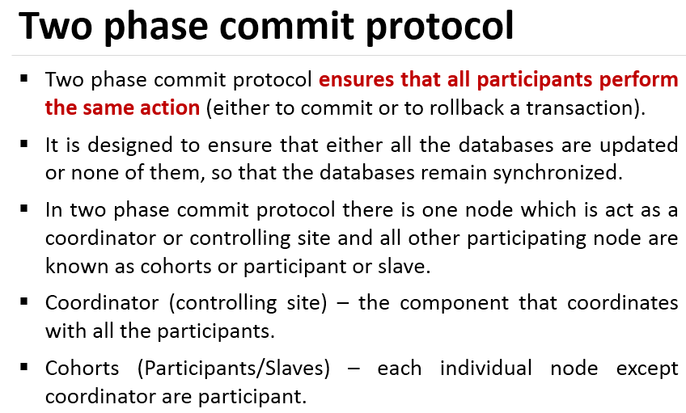

Slide 25
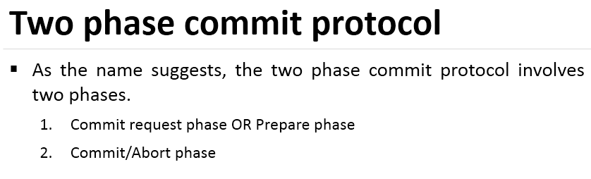

Slide 26
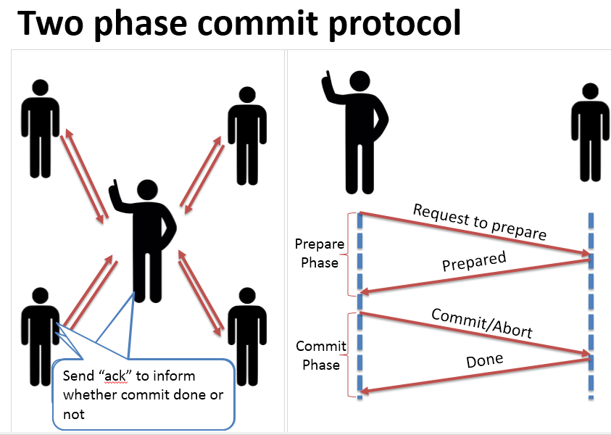

Slide 27
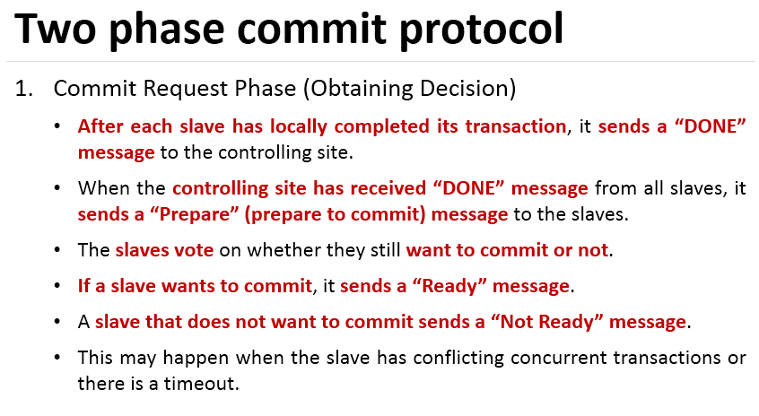

Slide 28
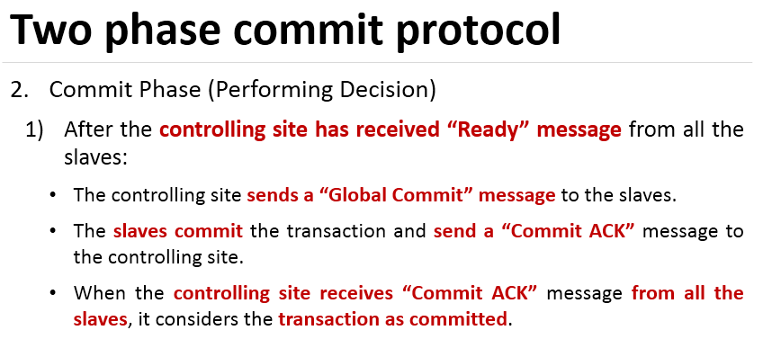

Slide 29
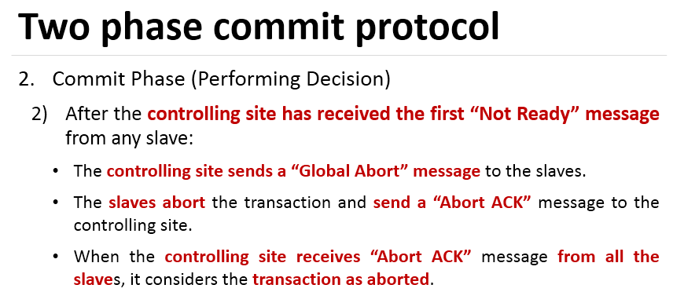

Slide 30
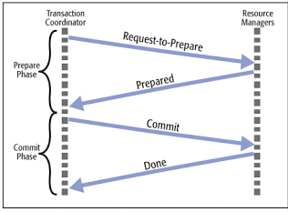
Two phase commit protocol
Atomic commitment protocol
Distributed algorithm that coordinates all process and participate in a distributed atomic transaction, whether to commit or abort T

Slide 31
Limitation
Block Problem:
- Blocking reduces the availability of system since blocked transactions keep all the resources until they receive final command from coordinator.

Slide 32
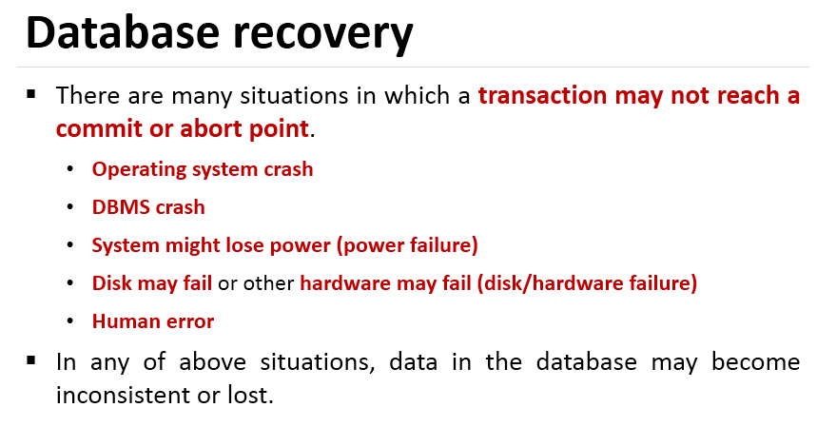

Slide 33
